Slide 1
Microprocessor

Slide 2
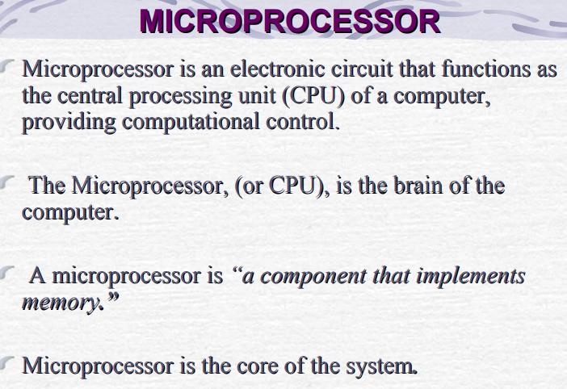

Slide 3
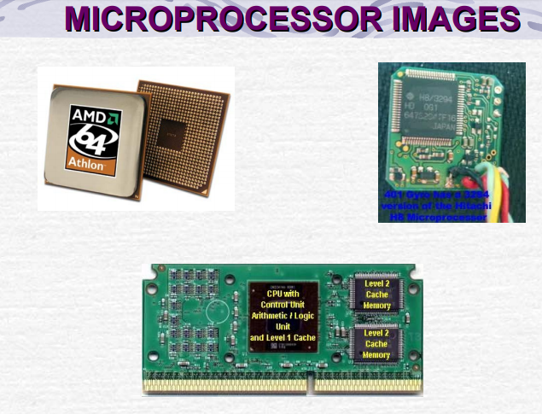

Slide 4
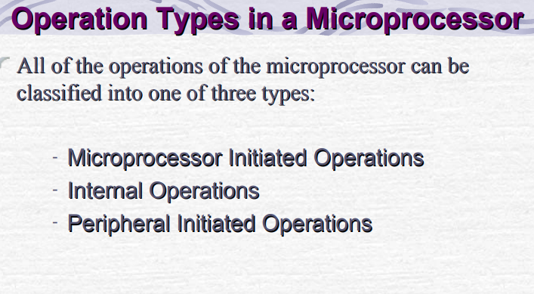

Slide 5
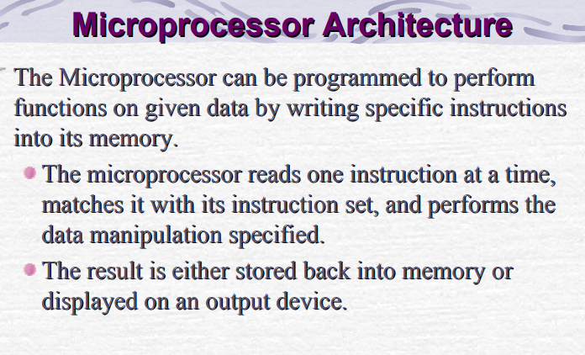

Slide 6
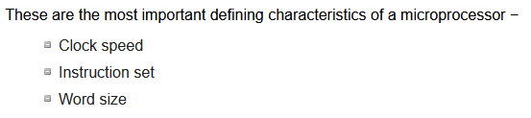
Microprocessors Characteristics

Slide 7
Clock Speed
Every microprocessor has an internal clock that regulates the speed at which it executes instructions and also synchronizes it with other components. The speed at which the microprocessor executes instructions is called clock speed. 8085 operates on a clock frequency of 3MHz–6MHz depending upon the version selected.
Word Size
Number of bits that can be processed by a processor in a single instruction is called its word size. Word size determines the amount of RAM that can be accessed at one go and total number of pins on the microprocessor. A word size of an 8085 microprocessor is 8-bit.

Slide 8
Instruction Set
A command given to a digital machine to perform an operation on a piece of data is called an instruction. Basic set of machine level instructions that a microprocessor is designed to execute is called its instruction set. These instructions do carry out these types of operations −
Data transfer
Arithmetic operations
Logical operations
Control flow
Input/output and machine control

Slide 9
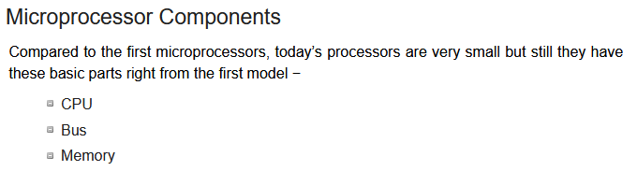

Slide 10
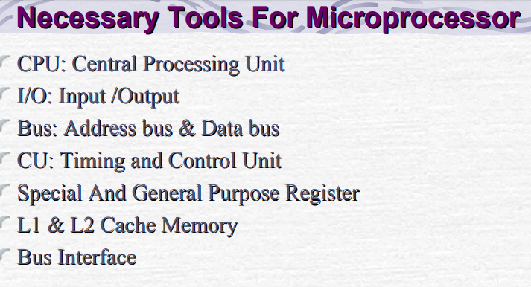

Slide 11
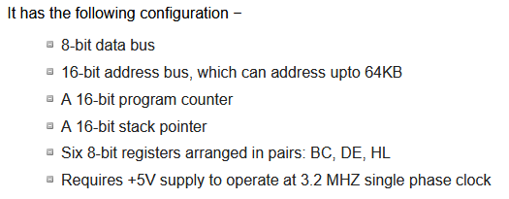
Microprocessor - 8085 Architecture

Slide 12
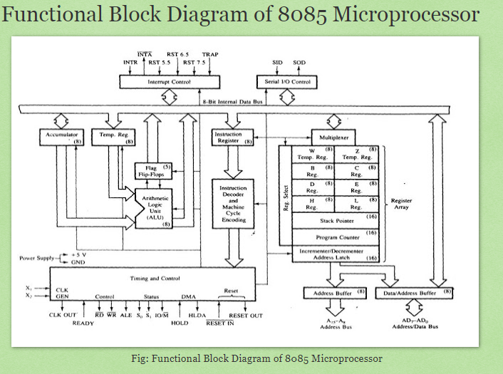

Slide 13
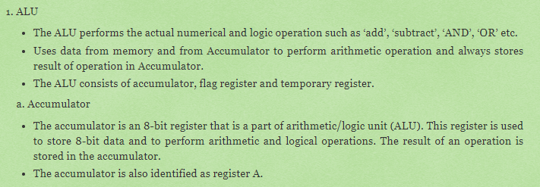


Slide 14

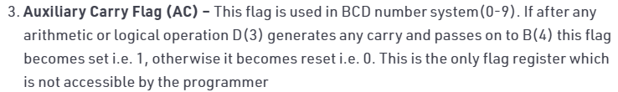

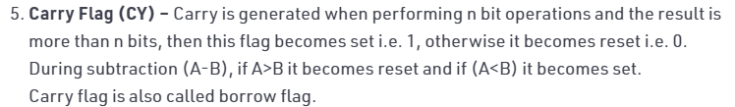

Slide 15
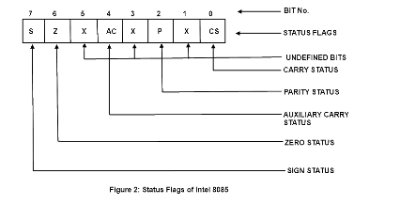
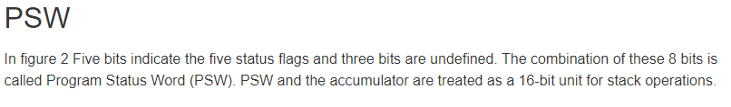

Slide 16
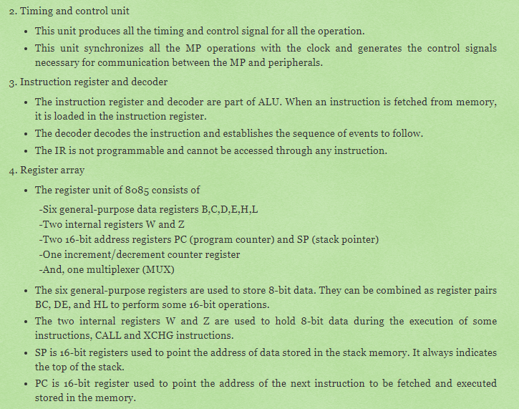

Slide 17
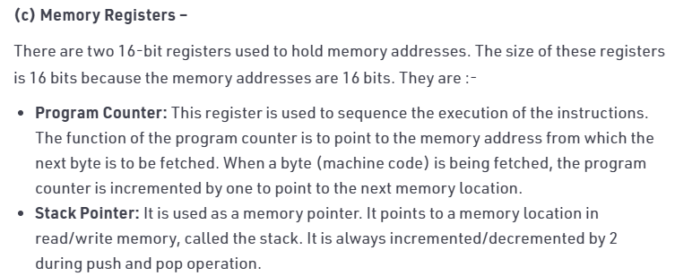
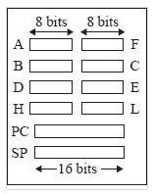

Slide 18
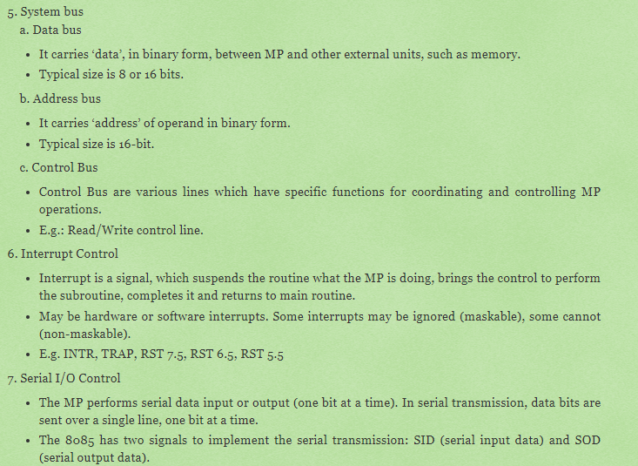

Slide 19
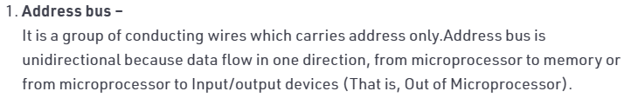
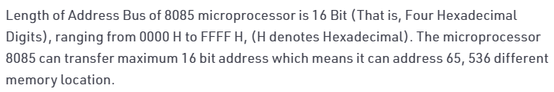
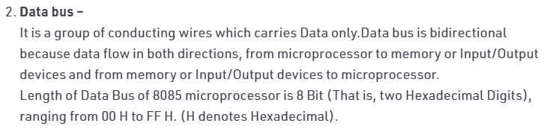

Slide 20
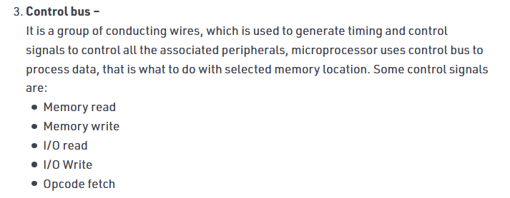

Slide 21
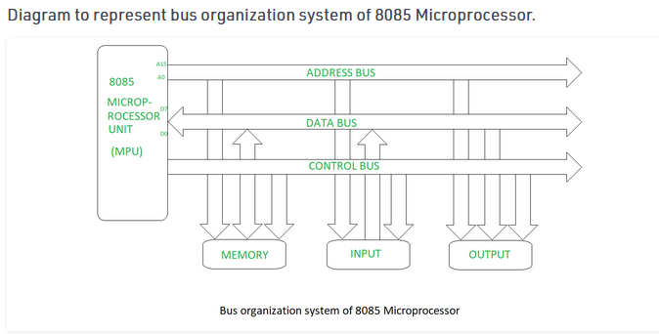

Slide 22
Thank you

